Slide 1

Digital Portfolio
STUDENT NAME: J. John Kingston
REGISTER NO AND NMID: 212401678,asnum219212401678
DEPARTMENT: Bachelor of Computer Applications
COLLEGE: Nazareth College of Arts and Science
1
Notes:
1.7.2013
1

Slide 2

PROJECT TITLE
Portfolio Website
& Library Management System
2

Slide 3



AGENDA
- Introduction
- Problem Statement
- Project Overview
- End Users
- Tools & Technologies
- Portfolio Design
- Features & Functionality
- Results & Conclusion
3/21/2024 Annual Review
3

Slide 4

PROBLEM STATEMENT
Students often struggle to present their
skills and projects effectively to recruiters.
A structured digital portfolio solves this problem.
4

Slide 5

PROJECT OVERVIEW
Students often struggle to present their skills and
projects effectively to recruiters. A structured
digital portfolio solves this problem.
5

Slide 6

WHO ARE THE END USERS?
- Students
- Recruiters
- Teachers
- Project evaluators
6

Slide 7

TOOLS AND TECHNIQUES
- HTML, CSS, JavaScript
- Python
- UI/UX Design
- Diploma in Computer Applications (DCA)
7

Slide 8
POTFOLIO DESIGN AND LAYOUT
-Clean, modern, and responsive layout
- Header with navigation
- About, Education, Skills, Projects, and Contact sections
- Grid-based skills and projects display
8

Slide 9
FEATURES AND FUNCTIONALITY
- User-friendly design
- Interactive navigation
- Contact form
- Highlighted projects and skills

Slide 10

RESULTS
A professional digital portfolio that helps showcase academic achievements, technical skills, and projects in an organized manner.
3/21/2024 Annual Review
10

Slide 11
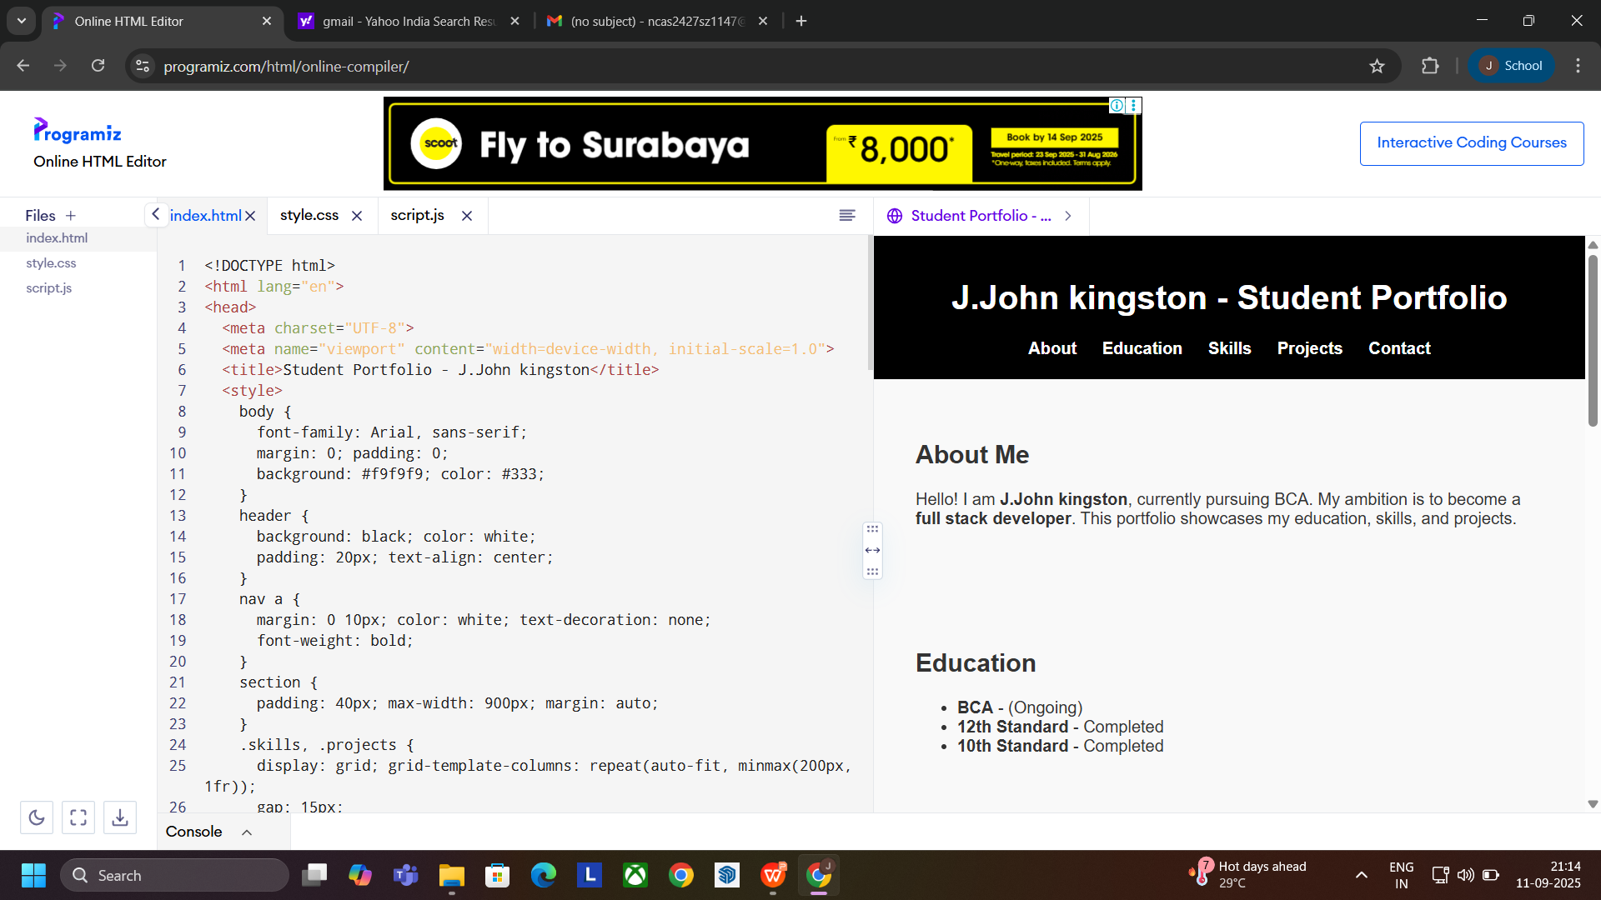
SCREENSHOTS
3/21/2024 Annual Review
10

Slide 12
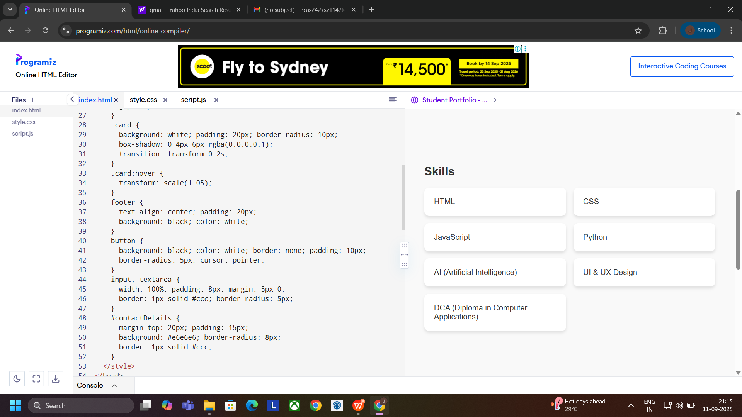
SCREENSHOTS
3/21/2024 Annual Review
10

Slide 13
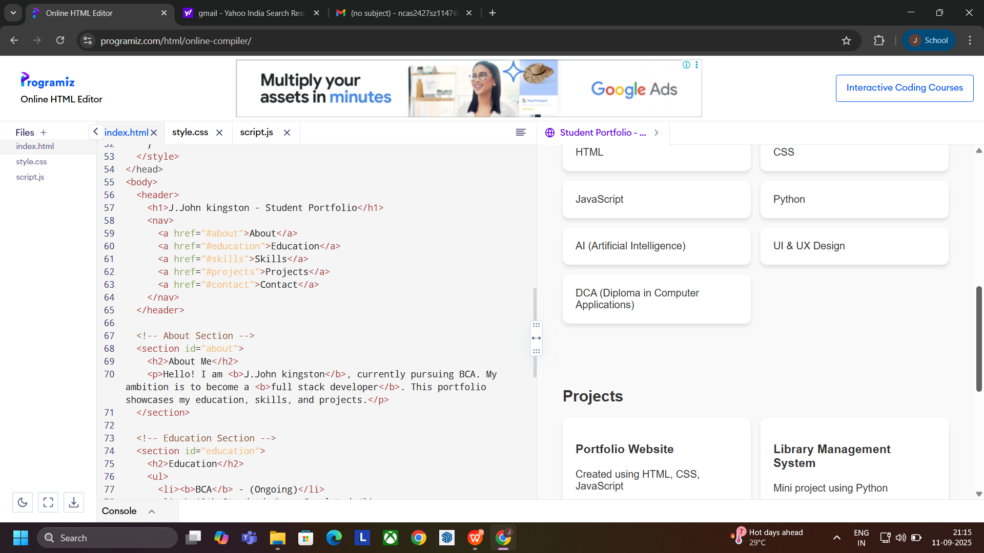
SCREENSHOTS
3/21/2024 Annual Review
10

Slide 14
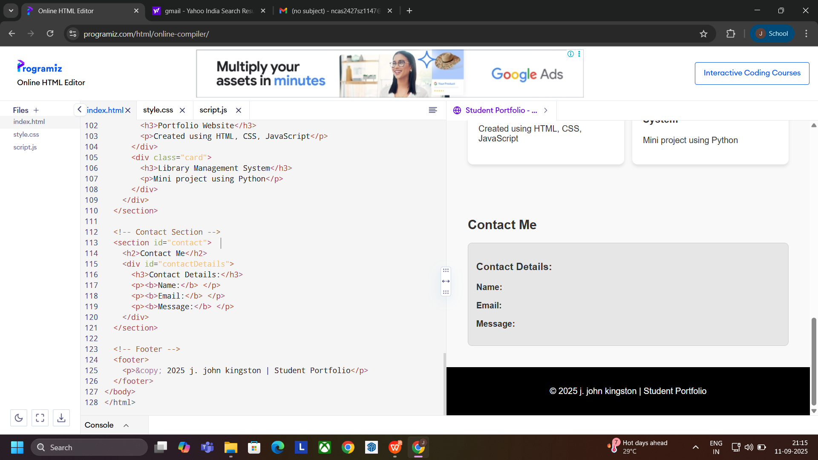
SCREENSHOTS
3/21/2024 Annual Review
10

Slide 15
CONCLUSION
The portfolio demonstrates technical expertise and creativity, serving as a bridge between academic learning and professional opportunities.
11

Slide 16
PROFILE
Name: J. John Kingston
Department: Bachelor of Computer Applications
College: Nazareth College of Arts and Science
Ambition: Full stack developer
11

Slide 17
THANK YOU
Thank you for viewing my portfolio presentation.
11

